Slide 1
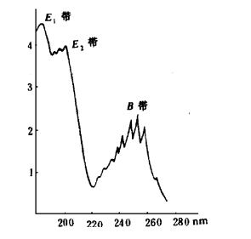

4) Aryl compounds
1) Benzene
Three absorption bands：E₁ band (184nm,ε=6×10⁴)、E₂ band (204nm,ε=7900) and B band (256nm,ε=200)
B band shows fine structures in gas phase or non-polar solutions
Auxochrome or larger conjugation: Red shift
Notes:
英: 1.17-18
中: 3.3.3

Slide 2
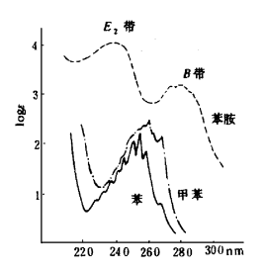
2) Substituted Benzene
Auxochrome substitution：
Lone pair electrons conjugate with benzene ring，causing red shifts of B band、E ₂ band.
Fine structures of B band disappear.

Slide 3
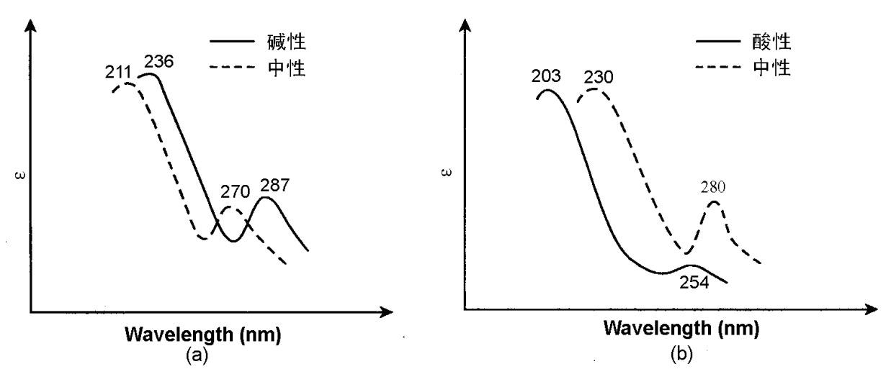
Electron distribution：
Phenol
Aniline

Slide 4
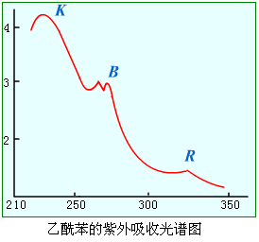
Larger conjugation/chromophore conjugation:
Large red shift for B band
Strong K band at 200 – 250 nm
Varied with different substitution positions （ortho-, meta-, para-）
C
H
3
n→ π∗ ; R带
C
O
π → π∗ ; K带

Slide 5
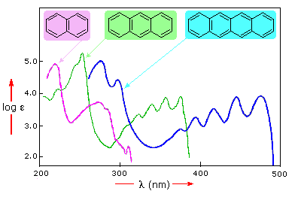
3）Polycyclic aromatic compounds
Three absorption bands：E₁ band 、E₂ band and B band, with fine structures.
More cyclic, Larger conjugation: Red shifts for all three bands; E₁ band >200nm、E₂ band or B band enter visible region with strong intensities.
Notes:
英: 1.19

Slide 6
4）Heteroaromatic compounds
Bezene like fine structures
Red shifts with larger conjugations
Varied with different substitution positions
Electron distribution effect
Notes:
英: 1.20-1.21
中: 3.3.4

Slide 7
4. Effects for UV-Vis spectrum
Conjugation Effect
Solvent Effect
pH Effect
Notes:
英: 1.2, 1.6-1.8
中: 3.2.2 影响因素

Slide 8
Conjugation Effect
Larger conjugation, Larger wavelength of λ_{max}

Slide 9
Solvent Effect
More polar:
For π−π*, red shift; For n−π*, blue shift
Fine structures lost

Slide 10
λ_{max}/nm
Hexane Chloroform Methanol Water
K 230 238 237 243 Red shift
R 329 315 309 305 Blue shift

Slide 11
UV spectra of 1,2,4,5-tetrazole

Slide 12
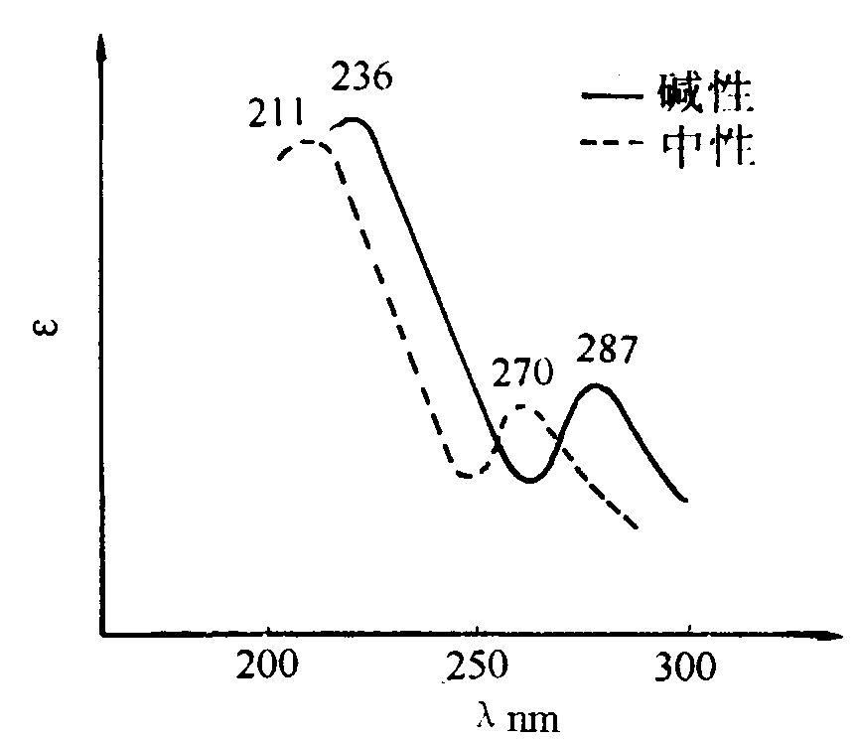
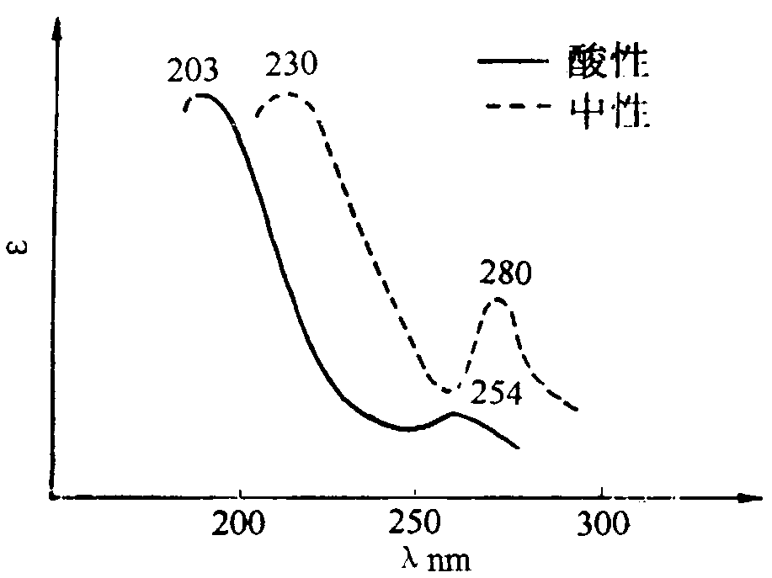
pH Effect
Phenol
Aniline

